Slide 1
Use Case Modeling

Slide 2
Use Case Modeling
The use case modeling shows us the possible behavior of how the software will perform.
The benefit of using the use case diagram is that we develop the system with the user in mind.
It is the best way to meet the requirements of the end-user.
The use case diagram illustrates the relationship between the multiple use-cases, actors, and systems.
The best practice is that the use case diagram should be small and crispy.
The use case diagram specifies how a system will perform, which is why it shows only the functionality of the system.

Slide 3
Use Case Diagram Notation
The use cases tell us about how the system will perform in different cases.
These use cases are made by keeping in mind what a user wants from the system.
Depending on the user's wants and needs, the use cases are made, and then the system is developed and tested according to these cases.

Slide 4
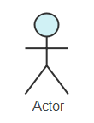
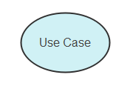
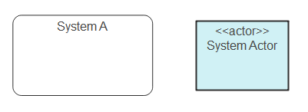
Use Case Notations (2)

Slide 5
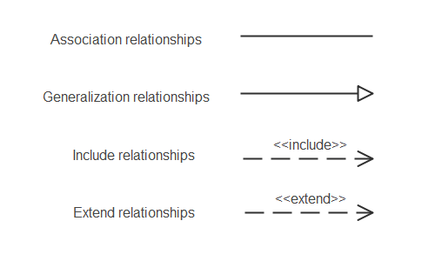
Relationships in the Use Case Diagram

Slide 6
Use Case Relationships
There can be 5 relationship types in a use case diagram.
Association between actor and use case
Generalization of an actor
Extend between two use cases
Include between two use cases
Generalization of a use case

Slide 7
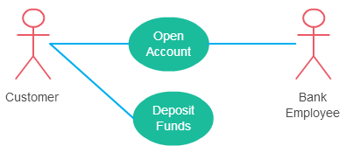
Association Between Actor and Use Case
An actor must be associated with at least one use case.
An actor can be associated with multiple use cases.
Multiple actors can be associated with a single use case.

Slide 8
Generalization of an Actor
Generalization of an actor means that one actor can inherit the role of the other actor.
The descendant inherits all the use cases of the ancestor.
The descendant has one or more use cases that are specific to that role.
Let’s expand the previous use case diagram to show the generalization of an actor.

Slide 9
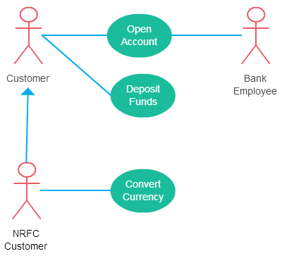

Slide 10
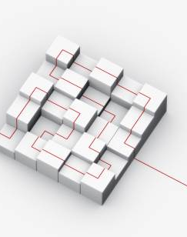
Extend Relationship Between Two Use Cases
The extending use case is dependent on the extended (base) use case. In the below diagram the “Calculate Bonus” use case doesn’t make much sense without the “Deposit Funds” use case.
The extending use case is usually optional and can be triggered conditionally. In the diagram, you can see that the extending use case is triggered only for deposits over 10,000 or when the age is over 55.
The extended (base) use case must be meaningful on its own. This means it should be independent and must not rely on the behavior of the extending use case.

Slide 11
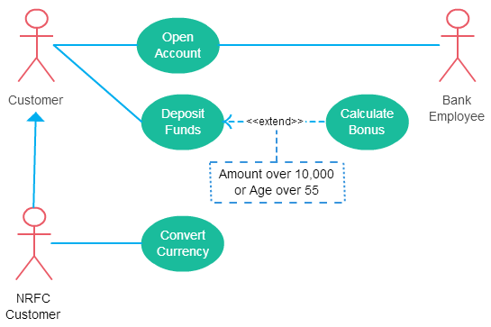

Slide 12
Include Relationship Between Two Use Cases
Include relationship show that the behavior of the included use case is part of the including (base) use case.
The main reason for this is to reuse common actions across multiple use cases.
In some situations, this is done to simplify complex behaviors. Few things to consider when using the <<include>> relationship.
The base use case is incomplete without the included use case.
The included use case is mandatory and not optional.

Slide 13
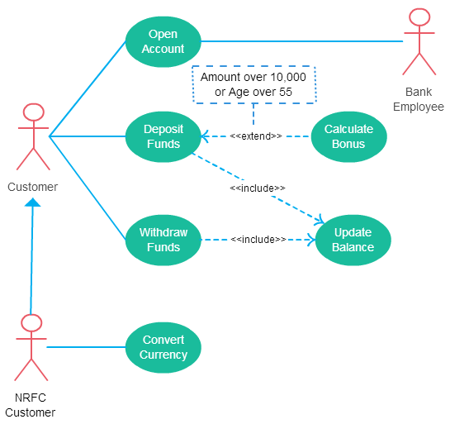

Slide 14
Generalization of a Use Case
This is similar to the generalization of an actor.
The behavior of the ancestor is inherited by the descendant.
This is used when there is common behavior between two use cases and also specialized behavior specific to each use case.
For example, in the previous banking example, there might be a use case called “Pay Bills”. This can be generalized to “Pay by Credit Card”, “Pay by Bank Balance” etc.

